Slide 1
Serverless Web Application using AWS
AMRITHA S S

Slide 2
PROJECT OVERVIEW
This project is a serverless web application
Backend is fully managed by AWS
No servers to maintain
Scalable and cost-effective
FOR EXAMPLE:
Users send requests through a web app
Data is processed using AWS Lambda
Data is stored in DynamoDB

Slide 3
PROBLEM STATEMENT
Traditional servers are costly and hard to manage
Scaling applications is difficult
Need an efficient, serverless solution

Slide 4
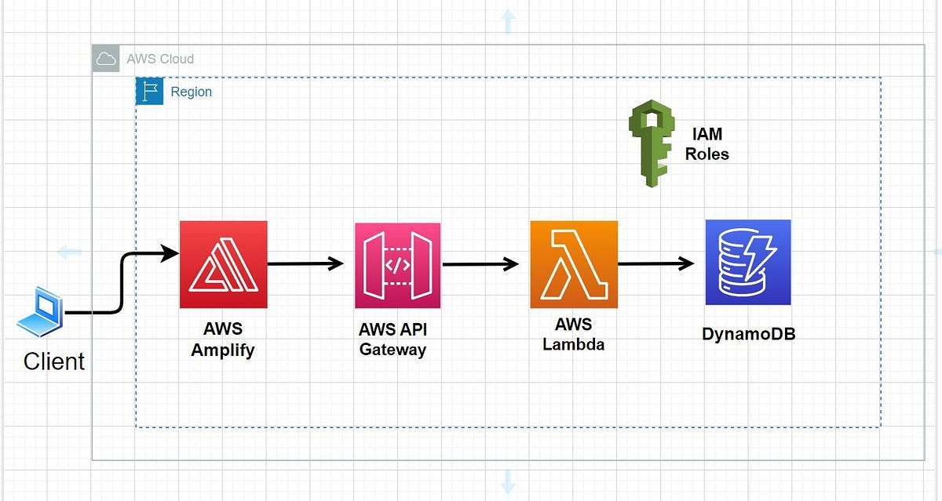
SOLUTION ARCHITECTURE

Slide 5
TECHNOLOGIES USED
AWS Lambda: Executes backend logic
API Gateway: Connects frontend and backend
DynamoDB: NoSQL database
AWS Amplify: Frontend hosting & integration
GitHub: Code version control

Slide 6
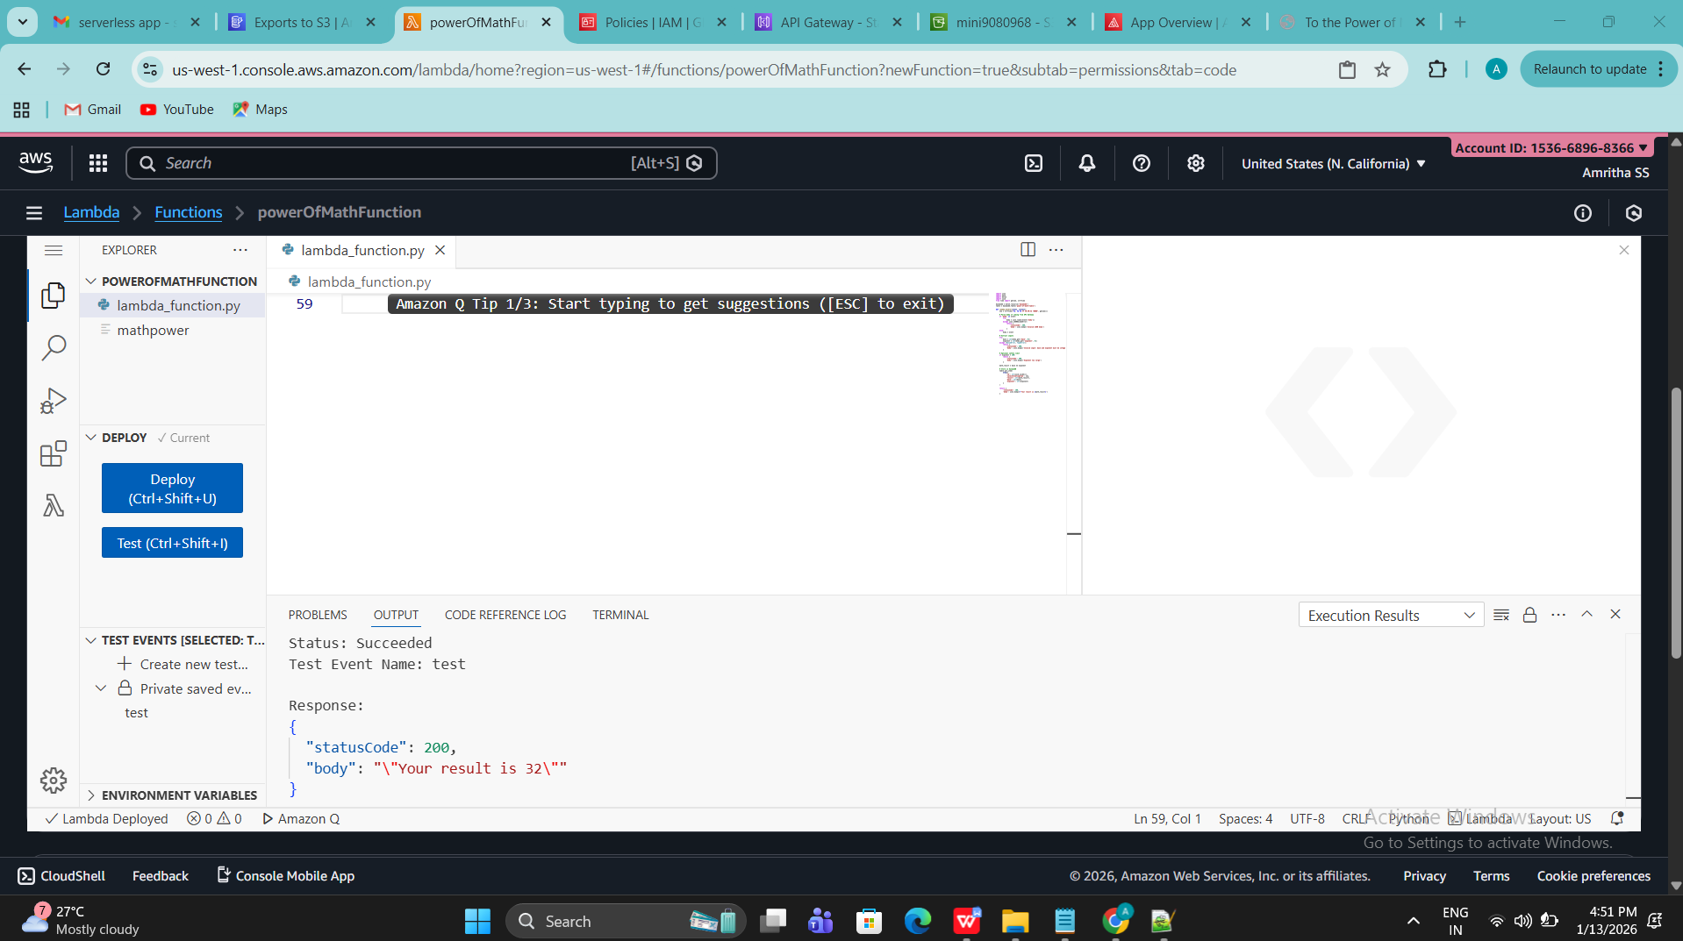
AWS LAMBDA
Handles requests
Processes input
Stores data into DynamoDB

Slide 7
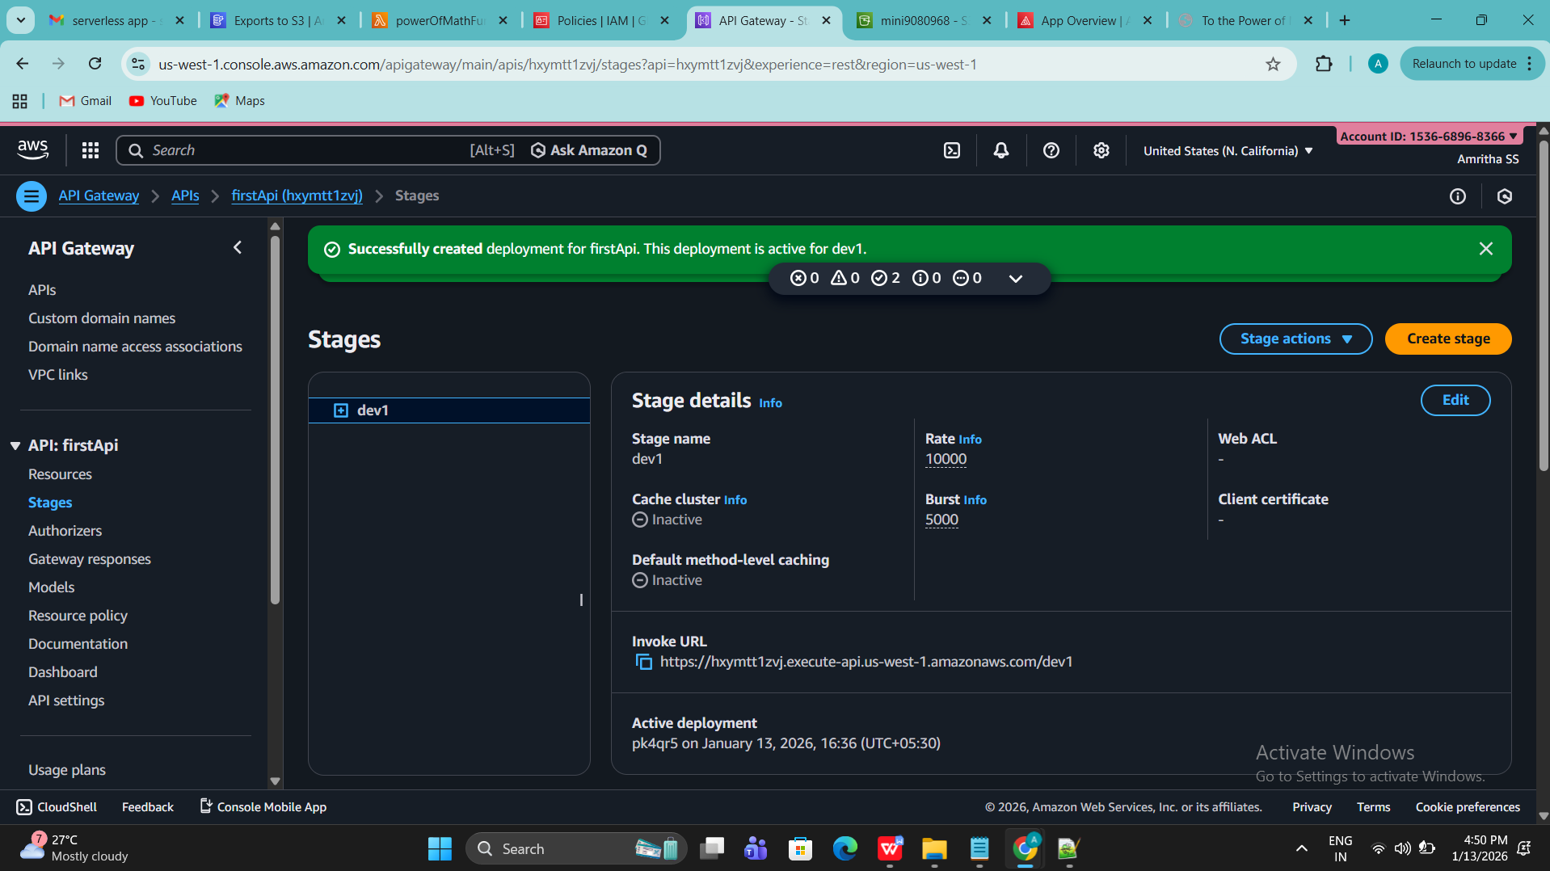
API GATEWAY
Acts as a bridge
Receives HTTP requests
Triggers Lambda function

Slide 8
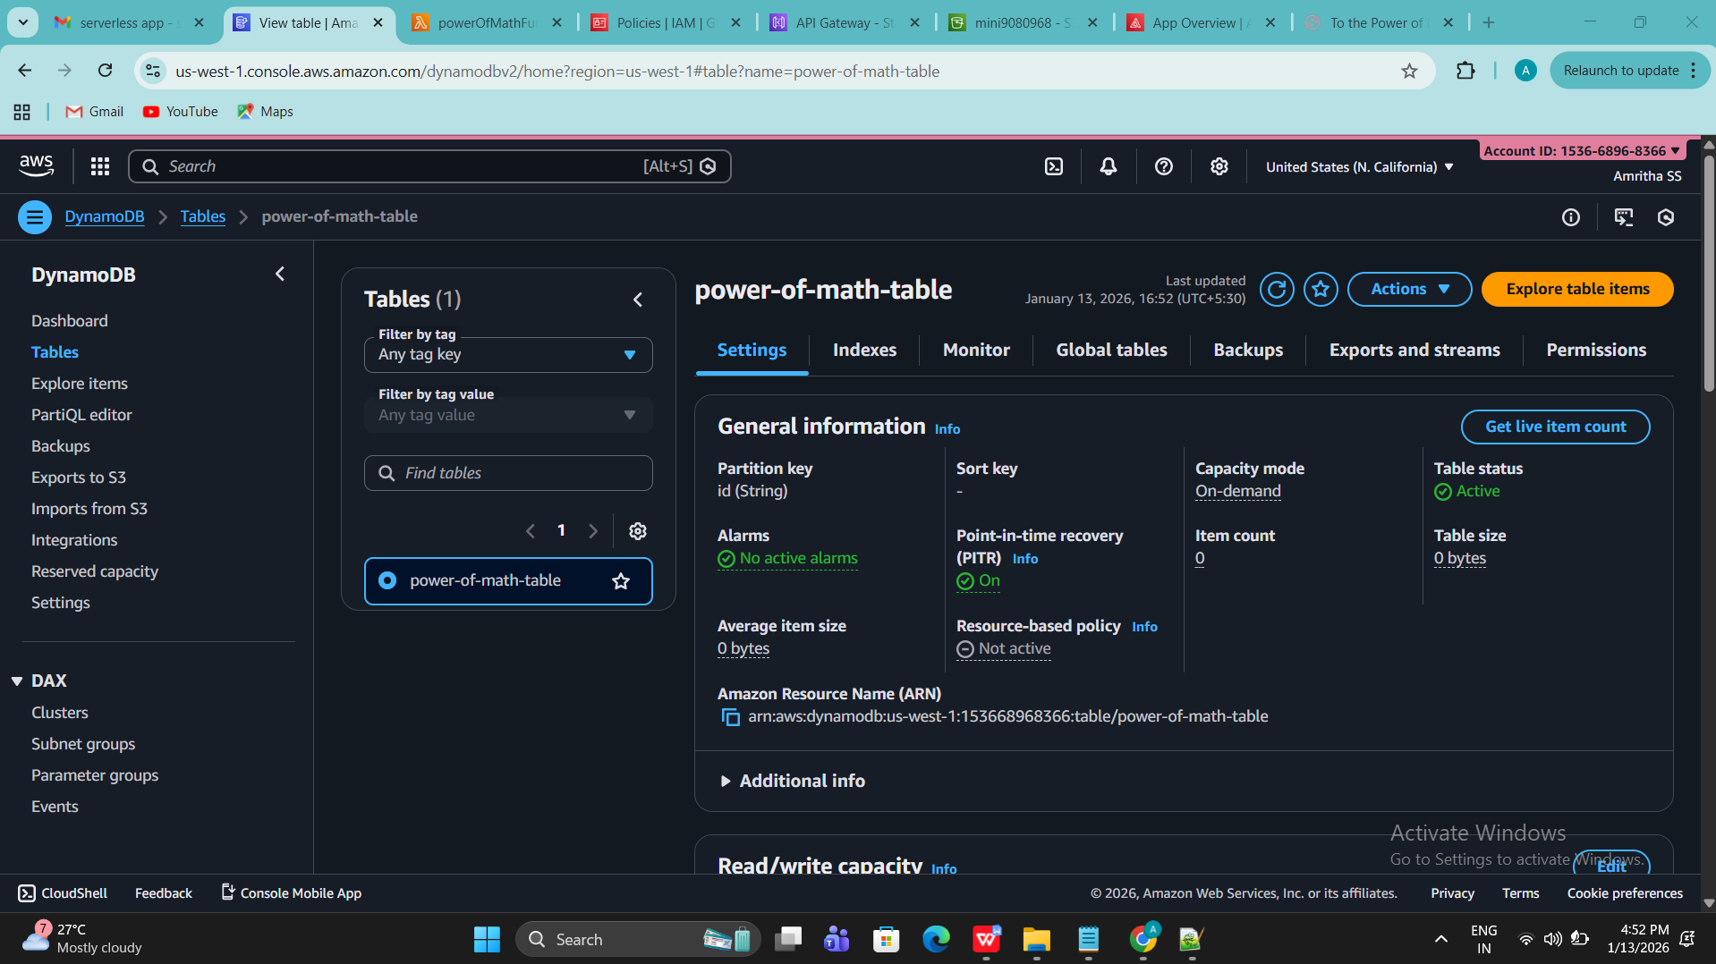
DYNAMO DB
Stores application data
Fully serverless
Fast and scalable

Slide 9
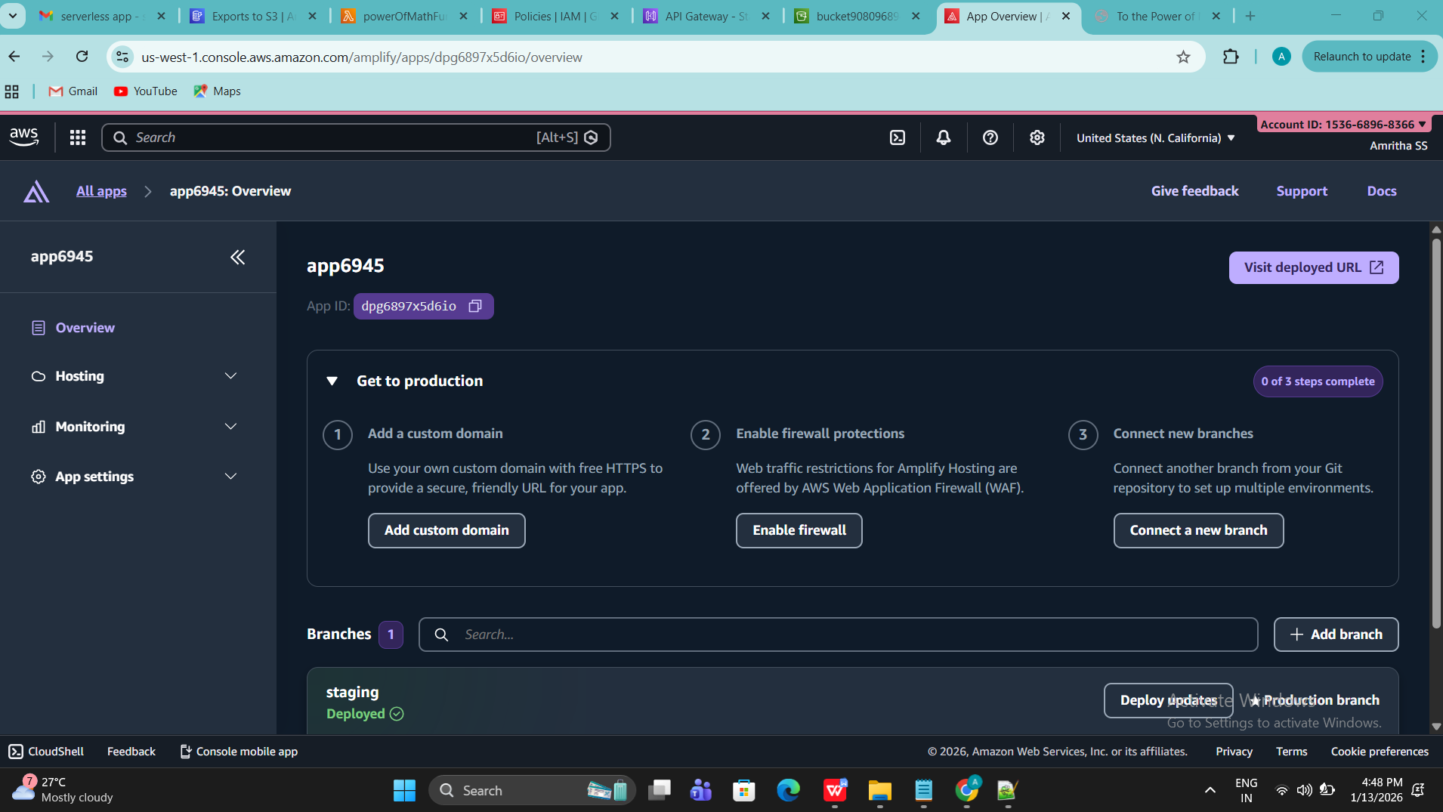
AWS AMPLIFY
Hosts frontend
Connects API easily
Enables CI/CD

Slide 10
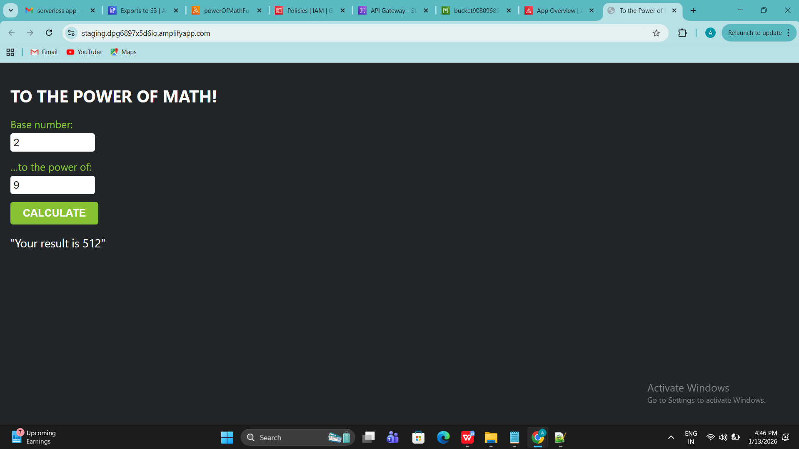
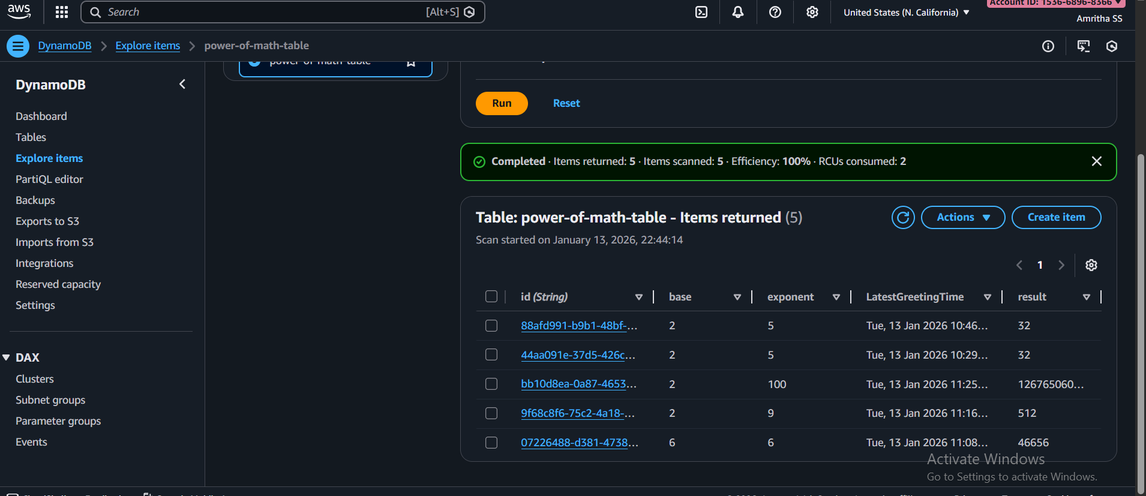
OUTPUT

Slide 11
ADVANTAGES
No server maintenance
High scalability
Low cost
Secure and reliable

Slide 12
CONCLUSION & FUTURE SCOPE
Successfully built a serverless application
Can extend with:
  Authentication (Cognito)
  Analytics
  More APIs

Slide 13
DONE & THANK YOU!!!!!

